Slide 1


The Acceptability of Accountability
John Bone
Paolo Crosetto
John Hey
Carmen Pasca
University of York
INRA
University of York
CMH- PARIS
funded by the Department of Economics, University of York
and conducted at

Slide 2
We are interested in social preferences.
We are particularly interested in income compensation schemes such as those discussed in Fleurbaey’s 2008 book Fairness, Responsibility and Welfare.
We want to elicit social preferences over such schemes.
We use experimental methods that have been used to elicit other kinds of preferences, such as, for example those over risk and time.
But we adopt a relatively new method – that of directly rather than indirectly eliciting preferences....
..with appropriately incentivised subjects.

Slide 3
We consider a particularly simple context.
We consider a society in which every member of society has an income...
... which has two independent components...
...one due to chosen effort (some or none) and the other due to chance (bad or good luck).
Income is lower with bad luck and lower with less effort.
These differences in incomes can be compensated through social dividends.
In the experiment, by principles chosen beforehand by subjects themselves.
We test the attractiveness of Liberal Egalitarianism, which implies compensating inequalities due to chance but not those due to effort.
(Note that the final payment to a member is the sum of income and the social dividend.)

Slide 4
Liberal Egalitarianism appears to provide a solution to the choice of the distribution rules that society should apply
respecting the decisions of individuals, yet treating equally individuals who are subject to different levels of luck.
This implies compensating individuals for bad luck, but not compensating them for choosing not to provide effort.
In terms of the distribution of the social dividend, this implies a dividend rule that provides Equal Payments for Equal Effort (thus compensating for bad luck) and Equal Dividends for Equal Luck (thus not compensating for lack of effort).
But first let me give some examples.

Slide 5
I assume incomes are
0 with bad luck and no effort
4 with good luck and no effort
6 with bad luck and effort
10 with good luck and effort
Start with Equal Payments everywhere (with a total social dividend X of zero). Just look at the left-hand box.

Slide 6
Now Equal Payments everywhere but with a total social dividend X of 40.
Now look at the middle box.

Slide 7
Equal Payments everywhere (with a total social dividend X of 40) but not all cells occupied (now look at the right-hand box)
So, obviously the number of cells occupied affects the final payments.

Slide 8
Equal dividends for all, with social fund of 40.
(look at left-hand box)

Slide 9
Liberal Egalitarian position: Equal Dividends for Luck; Equal Payment for Effort (look at the middle box)

Slide 10
Liberal Egalitarian position: Equal Dividends for Luck; Equal Payment for Effort. Not all cells occupied (look at the right-hand box)
So, once again, the number of cells occupied affects the final payments.

Slide 11
Consider incomes
0 with bad luck and no effort
8 with good luck and no effort
6 with bad luck and effort
10 with good luck and effort
But note: there is a problem if the income differential due to effort is NOT the same at each level of luck.
We cannot satisfy everything
We could have equal dividends at each level of luck, but NOT equal payments at each level of effort (look at the left-hand box)

Slide 12
Consider incomes
0 with bad luck and no effort
8 with good luck and no effort
6 with bad luck and effort
10 with good luck and effort
…or we could have equal payments at each level of output, but NOT equal dividends at each level of luck (look at the middle box)

Slide 13
Consider incomes
0 with bad luck and no effort
8 with good luck and no effort
6 with bad luck and effort
10 with good luck and effort
… unless not all the cells are occupied.
(look at the right-hand box)
But this is rather trivial and unlikely to be the case.

Slide 14
We interrupt this discussion to ask if these are normative or positive principles.
We think that they are normative but that it may be the case that actual social preferences agree with them.
The Rawlsian position seems to be that one can elicit normative principles if one puts the decider behind the veil of ignorance – hence being an impartial but interested member of society.
We have treatments in which this is as near as we can get to Rawls’ idea – in that the subjects must state their agreement or otherwise to principles before he or she knows whether he or she will have bad or good luck and before deciding whether to make effort or not. We call these Internal Dictator treatments.
We also have (External Dictator) treatments in which the principles implemented are those of a subject outside society and to whom the principles will not be applied, and hence is a disinterested subject (but incentivised in that his principles will be applied to others).

Slide 15
We want to see if these Luck-Egalitarian principles command agreement.
We have an experiment structured as follows:
There are two Parts: Part 1 in which subjects express their preferred principles; Part 2 in which those who (choose to) make an effort do a menial and mundane time-wasting task.
The principles actually implemented are those of a randomly chosen member of society (chosen after principles have been expressed).
Subjects do not know until they have expressed their preferences whether they will have Bad luck or Good luck.
The actual incomes for the various Luck/Effort combinations are not revealed until after principles expressed.
So subjects do not know ex ante whether they will be making effort or not.

Slide 16
To make the expression of principles easier the experiment was in five scenarios:
Scenario 1a: All members Leave after Part 1; members individually have Bad or Good luck;
Scenario 1b: All members Stay for Part 2; members individually have Bad or Good luck;
Scenario 2a: All members have Bad luck; members individually choose to Leave or Stay;
Scenario 2b: All members have Good luck; members individually choose to Leave or Stay.
Scenario 3: There may be members with Bad Luck and Good Luck and who choose to exert effort (Stay) and who exert no effort (Leave)

Slide 17
the standard scenario, played out at the end of Part 1
Bad Luck
Bad or Good?
Good Luck
each subject discovers his/her luck
(50:50 independently)

Slide 18
the standard scenario, played out at the end of Part 1
Leave after Part 1
Stay for Part 2
*
Bad Luck
Bad Luck
Good Luck
Good Luck
Leave
Stay
each subject chooses independently
*
(a 20-minute onscreen questionnaire)

Slide 19
the standard scenario, played out at the end of Part 1
Leave after Part 1
Stay for Part 2
Bad/Leave
Bad/Stay
Bad Luck
Good/Leave
Good/Stay
Good Luck

Slide 20
the standard scenario, played out at the end of Part 1
Leave after Part 1
Stay for Part 2
Bad/Leave
Bad/Stay
Bad Luck
Income
w₀₀
Income
w₀₁
w₀₀ ≤ w₀₁
≤ w₁₁
Good/Leave
Good/Stay
Good Luck
Income
w₁₀
Income
w₁₁
w₀₀ ≤
w₁₀ ≤ w₁₁
Income values are revealed to subjects in advance of the play-out.

Slide 21
the standard scenario, played out at the end of Part 1
Leave after Part 1
Stay for Part 2
Bad/Leave
Bad/Stay
Bad Luck
Income
w₀₀
Income
w₀₁
Payment
w₀₀ + x₀₀
Payment
w₀₁ + x₀₁
Good/Leave
Good/Stay
Good Luck
Income
w₁₀
Income
w₁₁
Payment
w₁₀ + x₁₀
Payment
w₁₁ + x₁₁
Income values are revealed to subjects in advance of the play-out.

Slide 22
the standard scenario, played out at the end of Part 1
Leave after Part 1
Stay for Part 2
Bad/Leave
Bad/Stay
Bad Luck
Income
w₀₀
Income
w₀₁
Dividend
x₀₀
Dividend
x₀₁
Payment
w₀₀ + x₀₀
Payment
w₀₁ + x₀₁
Good/Leave
Good/Stay
Good Luck
Income
w₁₀
Income
w₁₁
Dividend
x₁₀
Dividend
x₁₁
Payment
w₁₀ + x₁₀
Payment
w₁₁ + x₁₁
Income values are revealed to subjects in advance of the play-out.
Dividend rules are revealed to subjects in advance of the play-out …
… having been selected by the subjects themselves, earlier in Part 1.

Slide 23
For Part 1, subjects are grouped randomly into four-member societies.
Each society has £40 to distribute, as dividends, between its four members.
Each society chooses, separately for each row/column, one of two rules:
Equality of Dividend
members receive equal dividends
Equality of Payment
members receive unequal dividends, offsetting their income differences
Each member privately makes his/her choice of dividend rules.
One of the four members is randomly selected as the dictator for that society.
The dictator’s choice of dividend rules then applies to that society, and is revealed to all members before the play-out.

Slide 24
Let us remind you of the Liberal Egalitarian (possibly envy-free) principles – or ‘fair dividend rules’:
Equal Payments for (both Bad and Good) Luck – given a level of Effort (social dividends compensate the Bad Luck);
Equal Dividends for (No and Some) Effort given a level of luck (no compensation for no effort).
(Do note that these are rather extreme – which may account for the results of the experiment. People may want partial or over-compensation or punishment.)
Also as we have already shown they are in general incompatible, and so someone who likes them in principle must be prepared to drop one of them – that is declare one rule as droppable.
To make the experiment a bit easier, all we asked subjects, in all situations, was to specify either Equal Dividends or Equal Payments when comparing two adjacent cells (see later).

Slide 25
fair
dividend rules
Leave after Part 1
Stay for Part 2
Bad/Leave
Bad/Stay
Bad Luck
Income
w₀₀
Income
w₀₁
Dividend
x₀₀
Dividend
x₀₁
Payment
w₀₀ + x₀₀
Payment
w₀₁ + x₀₁
Good/Leave
Good/Stay
Good Luck
Income
w₁₀
Income
w₁₁
Dividend
x₁₀
Dividend
x₁₁
Payment
w₁₀ + x₁₀
Payment
w₁₁ + x₁₁
£x₀₀ − £x₁₀ = £w₁₀ − £w₀₀
£x₀₁ − £x₁₁ = £w₁₁ − £w₀₁
Equal Payments for
Bad Luck and Good Luck

Slide 26
fair
fair^{(?)}
dividend rules
Leave after Part 1
Stay for Part 2
Bad/Leave
Bad/Stay
Bad Luck
Income
w₀₀
Income
w₀₁
Dividend
x₀₀
Dividend
x₀₁
£x₀₀ = £x₀₁
Payment
w₀₀ + x₀₀
Payment
w₀₁ + x₀₁
Good/Leave
Good/Stay
Good Luck
Income
w₁₀
Income
w₁₁
Dividend
x₁₀
Dividend
x₁₁
£x₁₀ = £x₁₁
Payment
w₁₀ + x₁₀
Payment
w₁₁ + x₁₁
£x₀₀ − £x₁₀ = £w₁₀ − £w₀₀
£x₀₁ − £x₁₁ = £w₁₁ − £w₀₁
Equal Payments for
Bad Luck and Good Luck
Equal Dividends for
Leave and Stay

Slide 27
fair^{(?)}
dividend rules
Leave after Part 1
Stay for Part 2
Bad/Leave
Bad/Stay
Bad Luck
Income
w₀₀
Income
w₀₁
Dividend
x₀₀
Dividend
x₀₁
£x₀₀ = £x₀₁
Payment
w₀₀ + x₀₀
Payment
w₀₁ + x₀₁
Good/Leave
Good/Stay
Good Luck
Income
w₁₀
Income
w₁₁
Dividend
x₁₀
Dividend
x₁₁
£x₁₀ = £x₁₁
Payment
w₁₀ + x₁₀
Payment
w₁₁ + x₁₁
possible only if:
£x₀₀ − £x₁₀ = £w₁₀ − £w₀₀
£w₀₁ + £w₁₀ = £w₀₀ + £w₁₁
£x₀₁ − £x₁₁ = £w₁₁ − £w₀₁
Equal Payments for
Bad Luck and Good Luck
Equal Dividends for
Leave and Stay

Slide 28
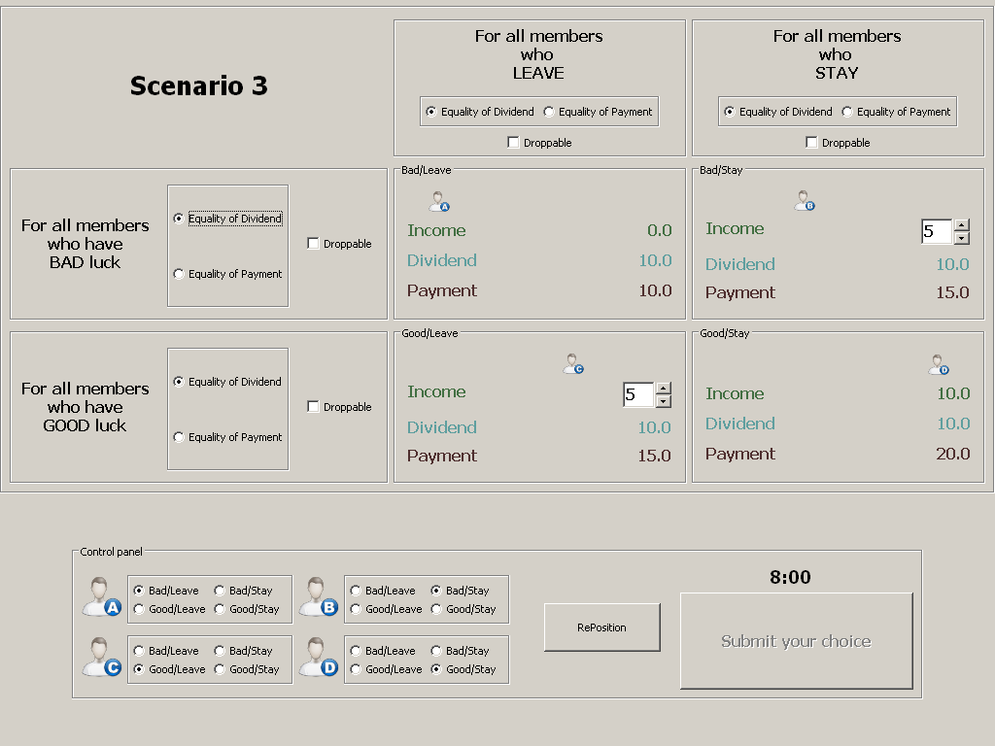

Time for some screenshots

Slide 30
Two treatments:
Equality of Dividend is default
Equality of Payment is default

Slide 32
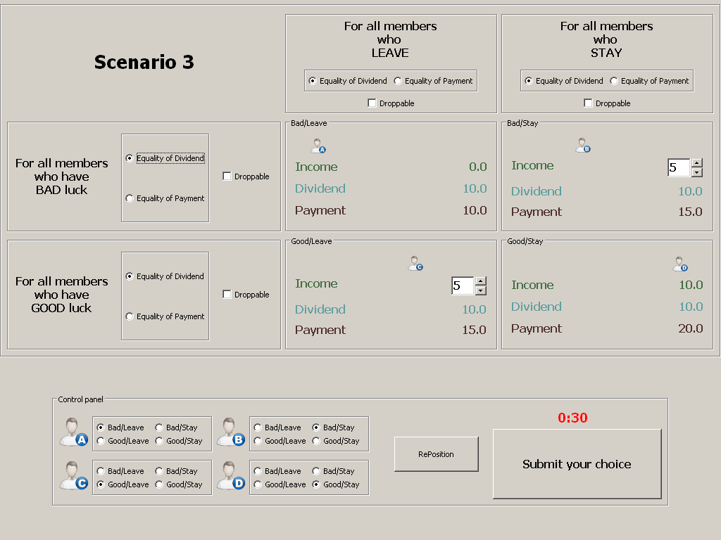
(the standard scenario)

Slide 33
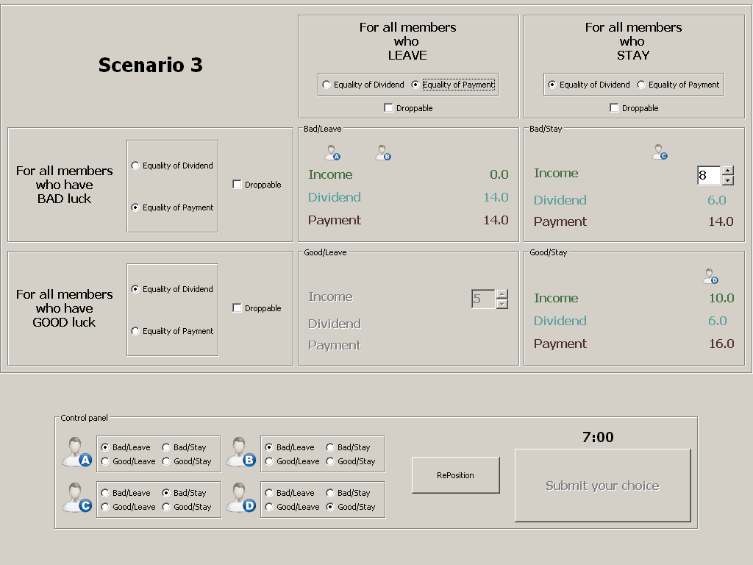

Slide 34
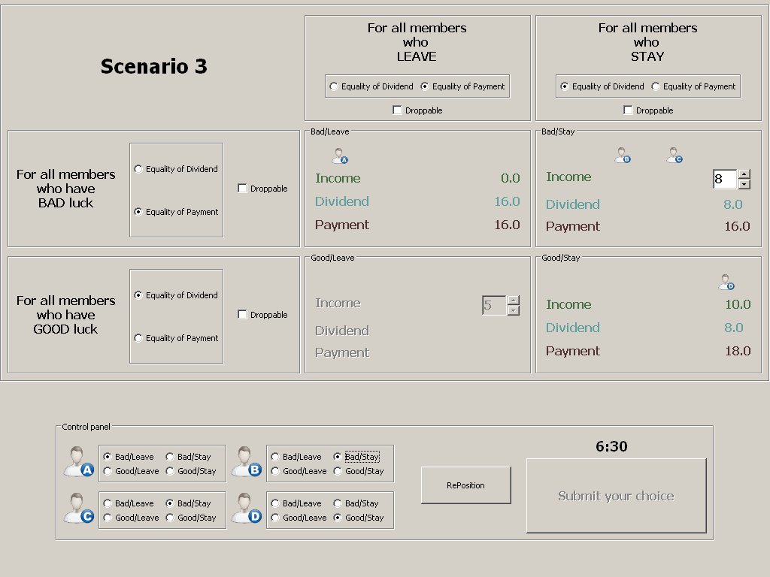

Slide 35
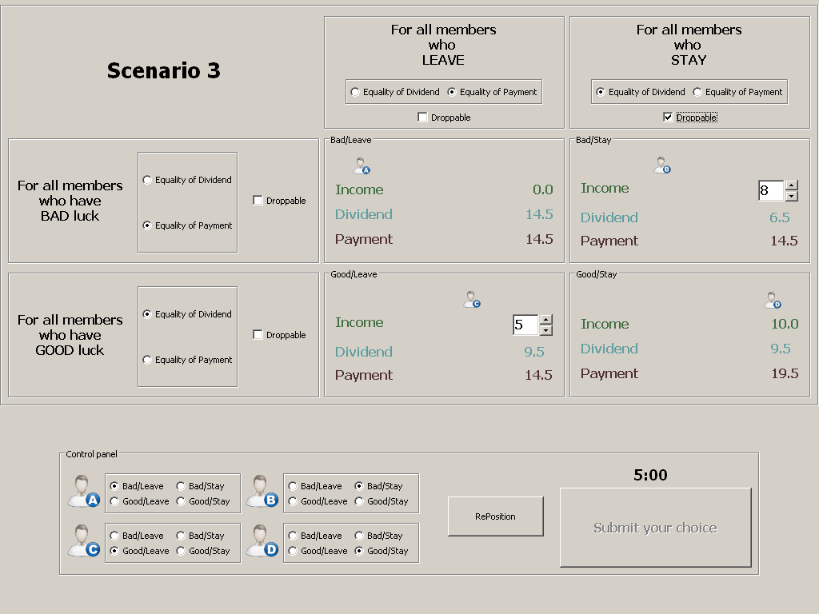

Slide 37
To make the experiment somewhat simpler, we first asked their rules over the
Four simple scenarios.

Slide 38
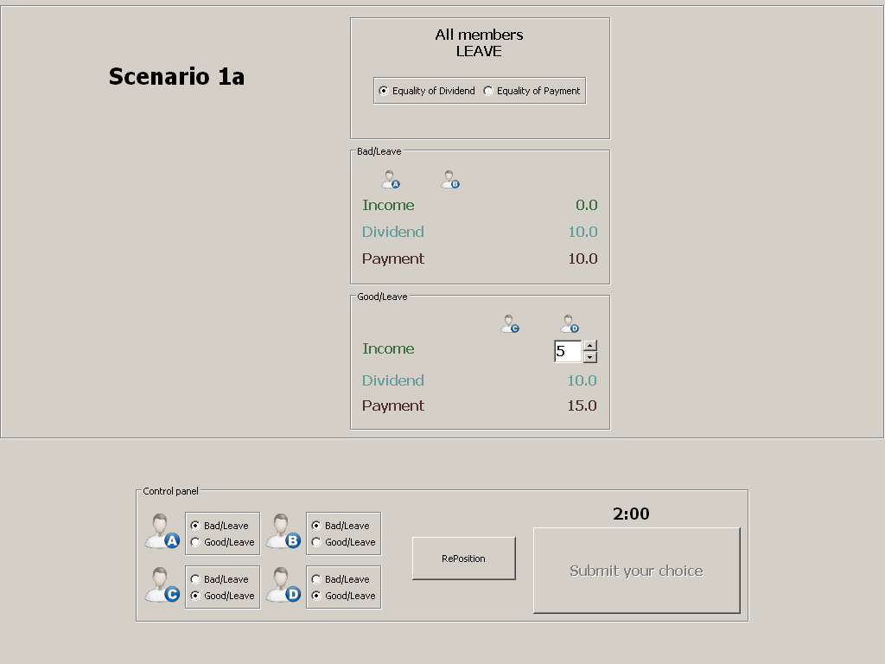

Slide 39
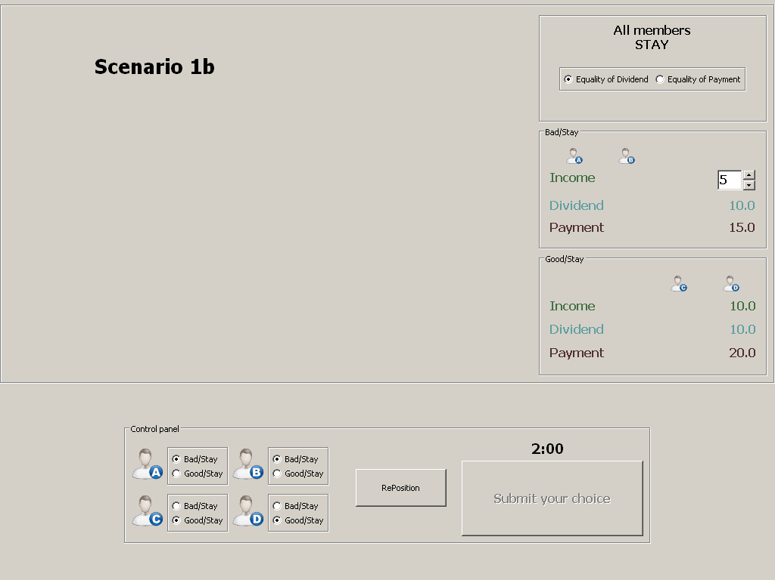

Slide 40
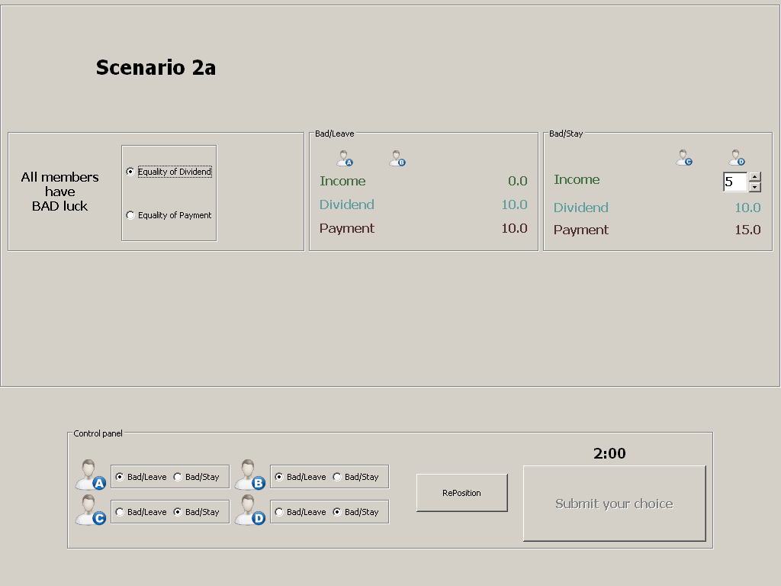

Slide 41
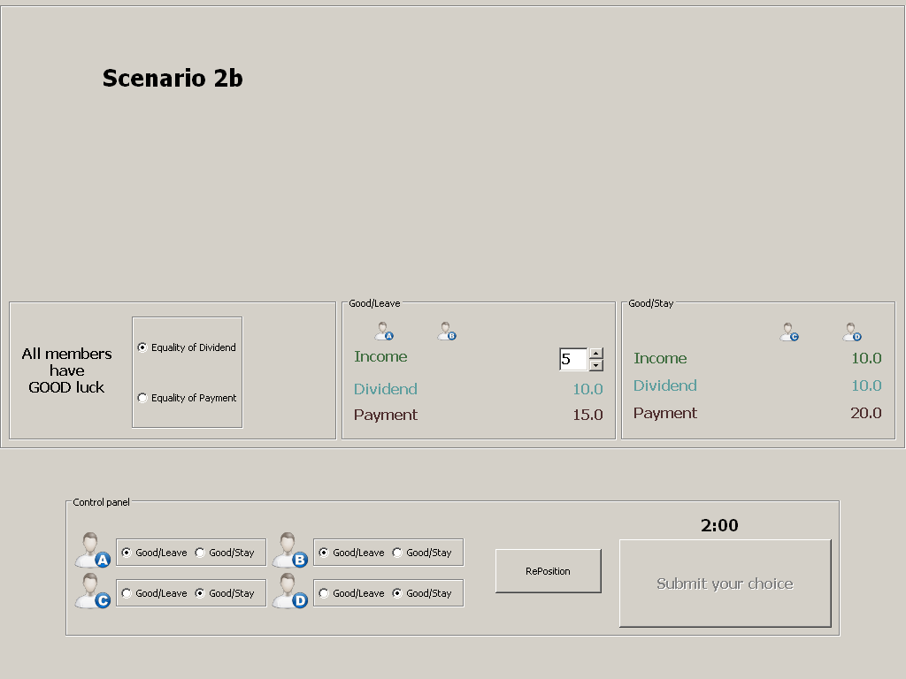

Slide 42
In each society:
each member makes a choice of dividend rule(s) for each of the five scenarios
one of the five scenarios is randomly selected for the play-out
all members are then informed of:
the scenario selected for that society
the dividend rule(s) for that scenario as chosen by the selected dictator
the income values for Bad/Stay and Good/Leave
members then individually play out that scenario, to finish Part 1.

Slide 43
The external dictator treatment
all as above, except that each society initially comprises five members
the selected dictator does not participate in the play-out
he or she Leaves at the end of Part 1, with a fixed payment of £20
2×2 treatment structure:
Internal dictator; Equal Dividends default
n = 60
Internal dictator; Equal Payments default
n = 60
External dictator; Equal Dividends default
n = 59
(don’t ask)
External dictator; Equal Payments default
n = 60
We had two different default treatments to see if there is any kind of ‘status quo’ effect.

Slide 44
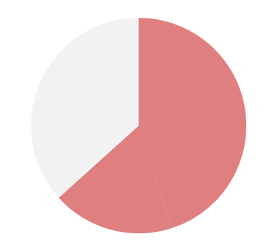
Internal dictator; Equal Dividends default
0.63
Leave after Part 1
Stay for Part 2
Bad/Leave
Bad/Stay
Bad Luck
Income
0.0
Income
Dividend
Dividend
Payment
Payment
Good/Leave
Good/Stay
Good Luck
Income
Income
10.0
Dividend
Dividend
Payment
Payment
Equal Payments for
Bad Luck and Good Luck
in Scenario 1a

Slide 45
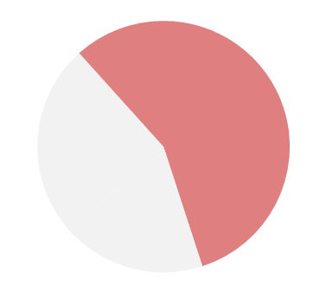
Internal dictator; Equal Dividends default
0.63
0.57
Leave after Part 1
Stay for Part 2
Bad/Leave
Bad/Stay
Bad Luck
Income
0.0
Income
Dividend
Dividend
Payment
Payment
Good/Leave
Good/Stay
Good Luck
Income
Income
10.0
Dividend
Dividend
Payment
Payment
Equal Payments for
Bad Luck and Good Luck
in Scenario 1b

Slide 46
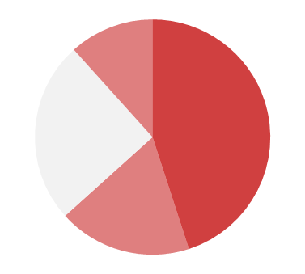
Internal dictator; Equal Dividends default
0.12
Stay
0.63
0.45
0.57
0.25
0.18
Leave
Leave after Part 1
Stay for Part 2
Bad/Leave
Bad/Stay
Bad Luck
Income
0.0
Income
Dividend
Dividend
Payment
Payment
Good/Leave
Good/Stay
Good Luck
Income
Income
10.0
Dividend
Dividend
Payment
Payment
Equal Payments for
Bad Luck and Good Luck
in both Scenarios 1a and 1b

Slide 47
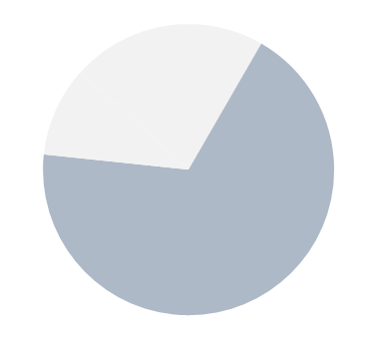
Internal dictator; Equal Dividends default
0.12
Stay
0.25
0.45
0.18
Leave
Leave after Part 1
Stay for Part 2
0.68
Bad/Leave
Bad/Stay
Bad Luck
Income
0.0
Income
Dividend
Dividend
Payment
Payment
Good/Leave
Good/Stay
Good Luck
Income
Income
10.0
Dividend
Dividend
Payment
Payment
Equal Dividends for
Leave and Stay
in Scenario 2a

Slide 48
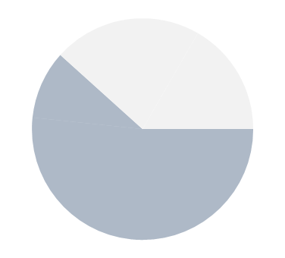
Internal dictator; Equal Dividends default
0.12
Stay
0.25
0.45
0.18
Leave
Leave after Part 1
Stay for Part 2
0.68
Bad/Leave
Bad/Stay
Bad Luck
Income
0.0
Income
Dividend
Dividend
Payment
Payment
Good/Leave
Good/Stay
Good Luck
Income
Income
10.0
Dividend
Dividend
Payment
Payment
0.62
Equal Dividends for
Leave and Stay
in Scenario 2b

Slide 49
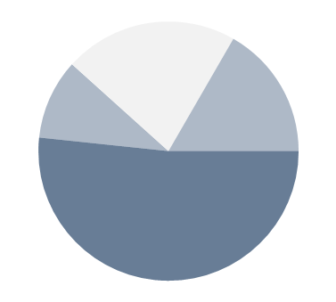
Internal dictator; Equal Dividends default
0.12
Stay
0.25
0.45
0.18
Leave
Leave after Part 1
Stay for Part 2
0.68
Bad/Leave
Bad/Stay
0.22
Bad Luck
Income
0.0
Income
0.10
0.17
Dividend
Dividend
Good Luck
Bad Luck
Payment
Payment
Good/Leave
Good/Stay
0.52
Income
Income
10.0
Good Luck
Dividend
Dividend
Payment
Payment
0.62
Equal Dividends for
Leave and Stay
in both Scenarios 2a and 2b

Slide 50
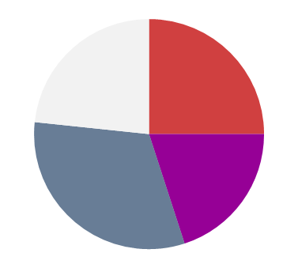
Internal dictator; Equal Dividends default
0.22
0.12
0.17
0.23
0.25
Stay
0.10
Bad Luck
Good Luck
0.45
0.25
0.52
0.32
0.20
0.18
Leave
Equal Dividends for
Leave and Stay
Equal Payments for
Bad Luck and Good Luck

Slide 51
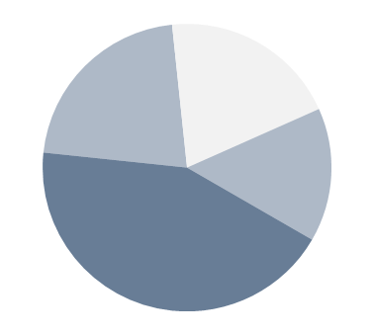
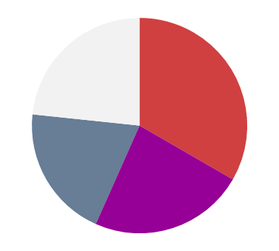
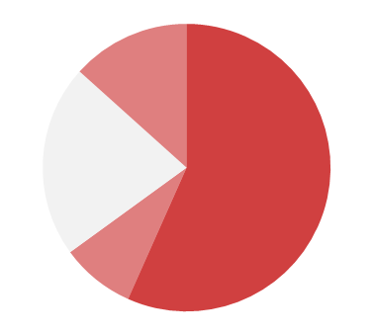
Internal dictator; Equal Dividends default
0.22
0.12
0.17
0.23
0.25
Stay
0.10
Bad Luck
Good Luck
0.45
0.25
0.52
0.32
0.20
0.18
Leave
Internal dictator; Equal Payments default
0.20
0.13
0.22
0.23
Stay
Good Luck
0.33
0.15
0.22
0.57
Bad Luck
0.43
0.20
0.23
0.08
Leave
Equal Dividends for
Leave and Stay
Equal Payments for
Bad Luck and Good Luck

Slide 52
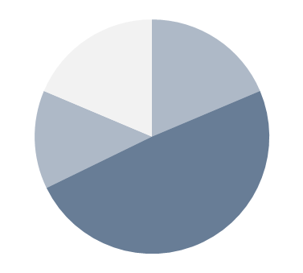
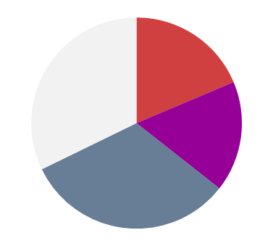
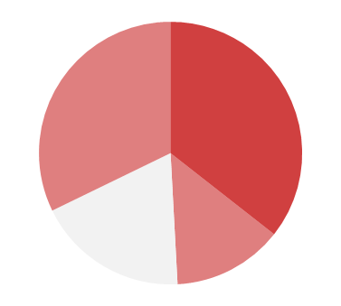
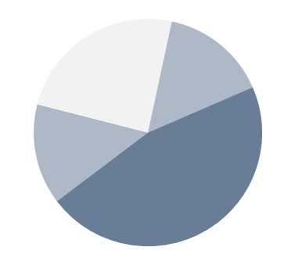
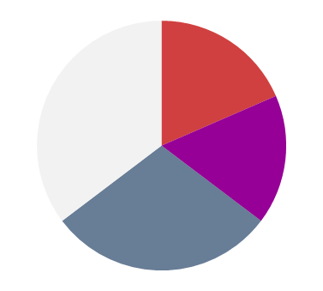
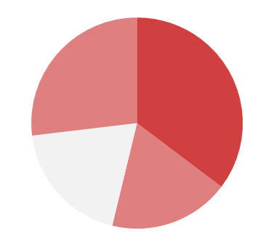
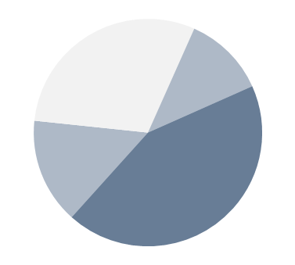
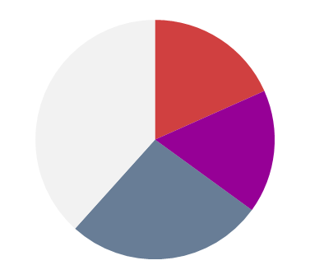
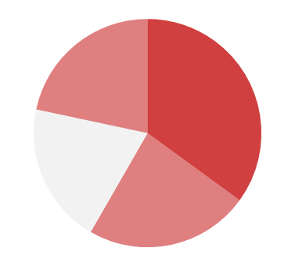
External dictator; Equal Dividends default
0.19
0.19
0.19
Bad Luck
0.32
0.32
0.36
0.14
Stay
Good Luck
0.17
External dictator; both subtreatments
(n = 119)
0.49
0.49
0.19
0.14
0.32
Leave
0.24
0.15
0.19
0.27
Bad Luck
Stay
0.35
0.35
0.14
0.17
Good Luck
External dictator; Equal Payments default
0.46
0.19
0.29
0.19
Leave
0.12
0.30
0.12
0.18
0.22
0.30
Bad Luck
Bad Luck
Stay
0.38
0.35
0.15
0.17
Good Luck
0.43
0.20
0.27
0.23
Leave
Equal Dividends for
Leave and Stay
Equal Payments for
Bad Luck and Good Luck

Slide 53
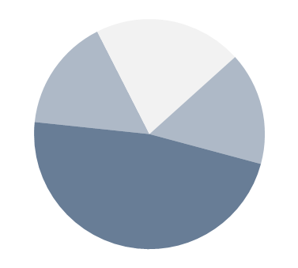
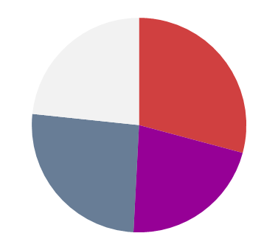
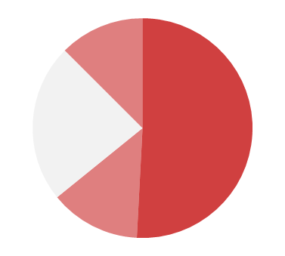
Internal dictator; both subtreatments
(n = 120)
0.21
0.13
0.16
0.23
Stay
Good Luck
0.16
0.29
Bad Luck
0.23
0.51
0.48
0.26
0.22
0.13
Leave
External dictator; both subtreatments
(n = 119)
0.24
0.15
0.19
0.27
Bad Luck
Stay
0.35
0.35
0.14
0.17
Good Luck
0.46
0.29
0.19
0.19
Leave
Equal Dividends for
Leave and Stay
Equal Payments for
Bad Luck and Good Luck

Slide 54
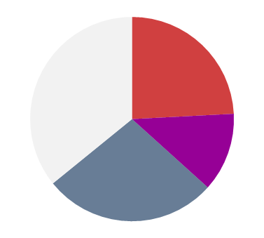
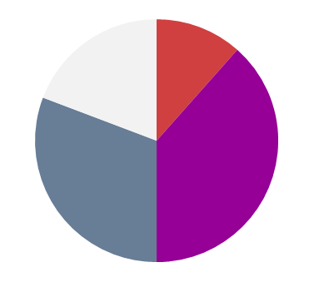
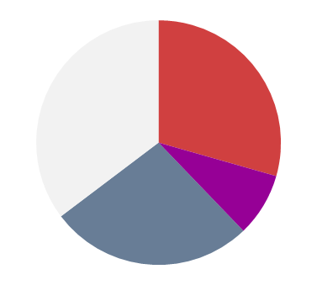
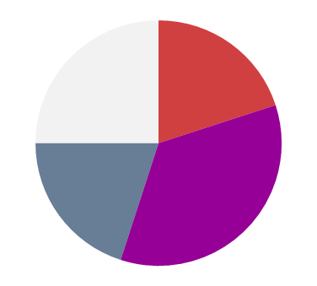
Internal dictator; both subtreatments
(n = 120)
0.23
0.29
0.24
0.36
0.13
0.26
0.22
0.28
External dictator; both subtreatments
(n = 119)
0.19
0.35
0.29
0.35
0.17
0.08
0.29
0.27
There is a modest treatment effect
Scenarios 1&2
Scenario 3

Slide 55
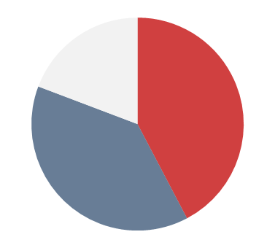
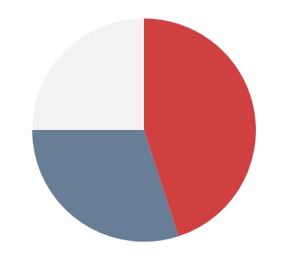
Internal dictator; both subtreatments
(n = 120)
0.23
0.29
3/26
5/26
5/26
0.26
0.22
11/26
8/26
10/26
10/26
External dictator; both subtreatments
(n = 119)
in effect,
with droppables
0.19
0.35
0.17
5/20
4/20
5/20
9/20
0.29
4/20
7/20
6/20
Scenarios 1&2
Scenario 3

Slide 56
So what have we learnt?
Even in the simple scenarios the support for the Liberal Egalitarian principles is not as strong as we would have expected.
It gets less in the complex scenario but perhaps that is understandable.
We think it is to do with the extreme nature of the compensation rules we offered: either total compensation or none.
We plan to do an experiment with the opportunity of partial compensation.

Slide 57
THANK YOU

